Slide 1
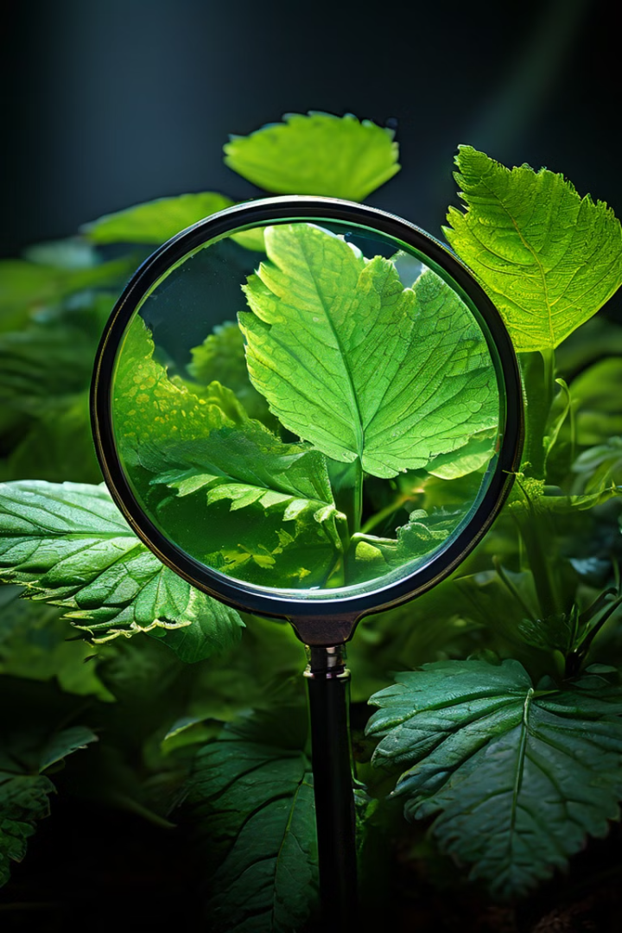

Plant Disease Detection Using Image Classification
A Computer Vision Approach
by Naman Singh

Slide 2

Problem Statement
Agriculture is a critical sector, and plant diseases can cause significant losses in crop yield. Early and accurate detection of plant diseases is essential for ensuring food security. Traditional methods of disease identification are time-consuming and require expert knowledge.
Objective: Develop an automated system that can accurately identify plant diseases using image classification.

Slide 3
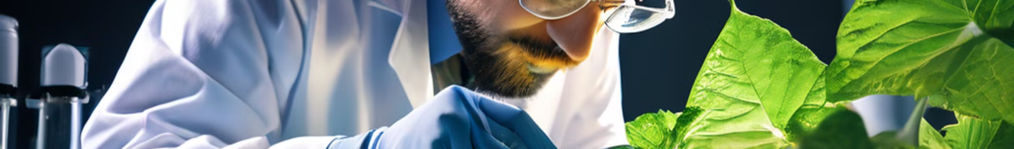



Proposed Solution
Utilizes a Vision Transformer model for high accuracy
Capable of identifying 28 different plant diseases
Deployed as an interactive web application using Gradio for real-time predictions
The system can accurately detect and classify a wide range of plant diseases.
Our model is trained on a diverse dataset of plant leaf images, representing different diseases.
The solution is easily accessible and user-friendly, allowing for quick and efficient disease detection.

Slide 4
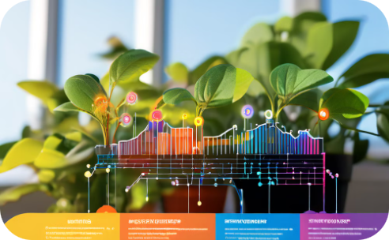

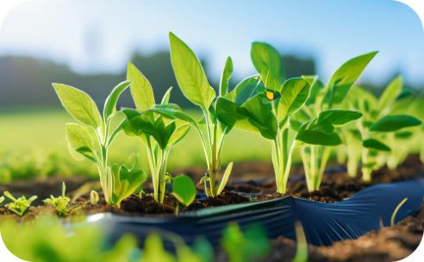
Technologies Used
Model Training and Evaluation
Image Classification
Web Application
EfficientNetB0 for image classification.
Gradio for deploying the model as a web application.
TensorFlow/Keras for model training and evaluation.

